Slide 1
Untangling the Boreal Carbon Puzzle: A Comparative Study of Biomass Maps
Kirsten Bauck April 19th, 2025

Slide 2

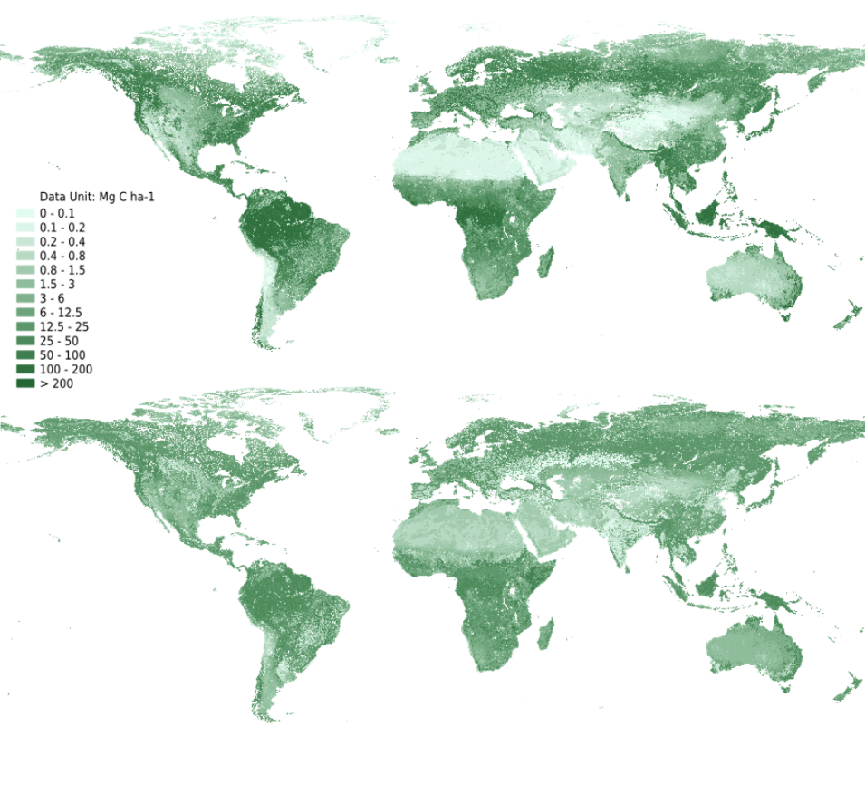


Why Biomass Estimates Matter
ORNL DAAC. Above and Below Ground Biomass. 2010. Mapping Carbon Beyond Forests, NASA

Slide 3
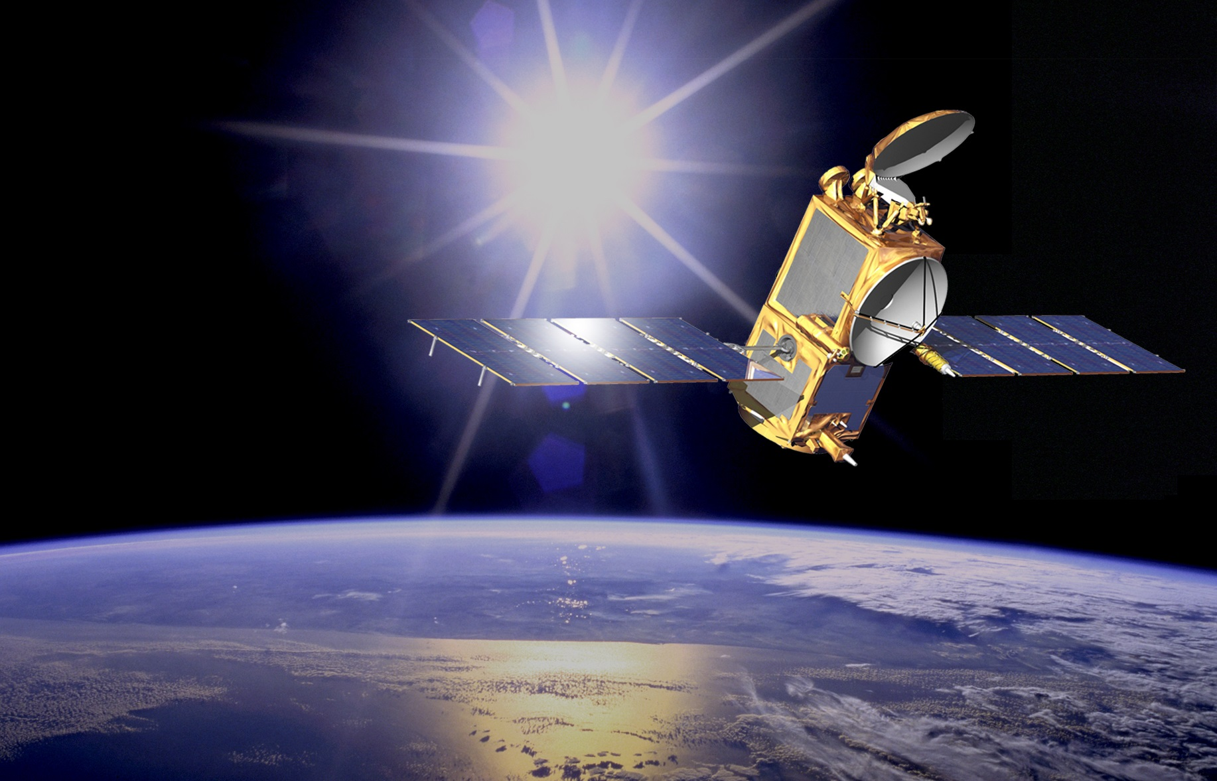
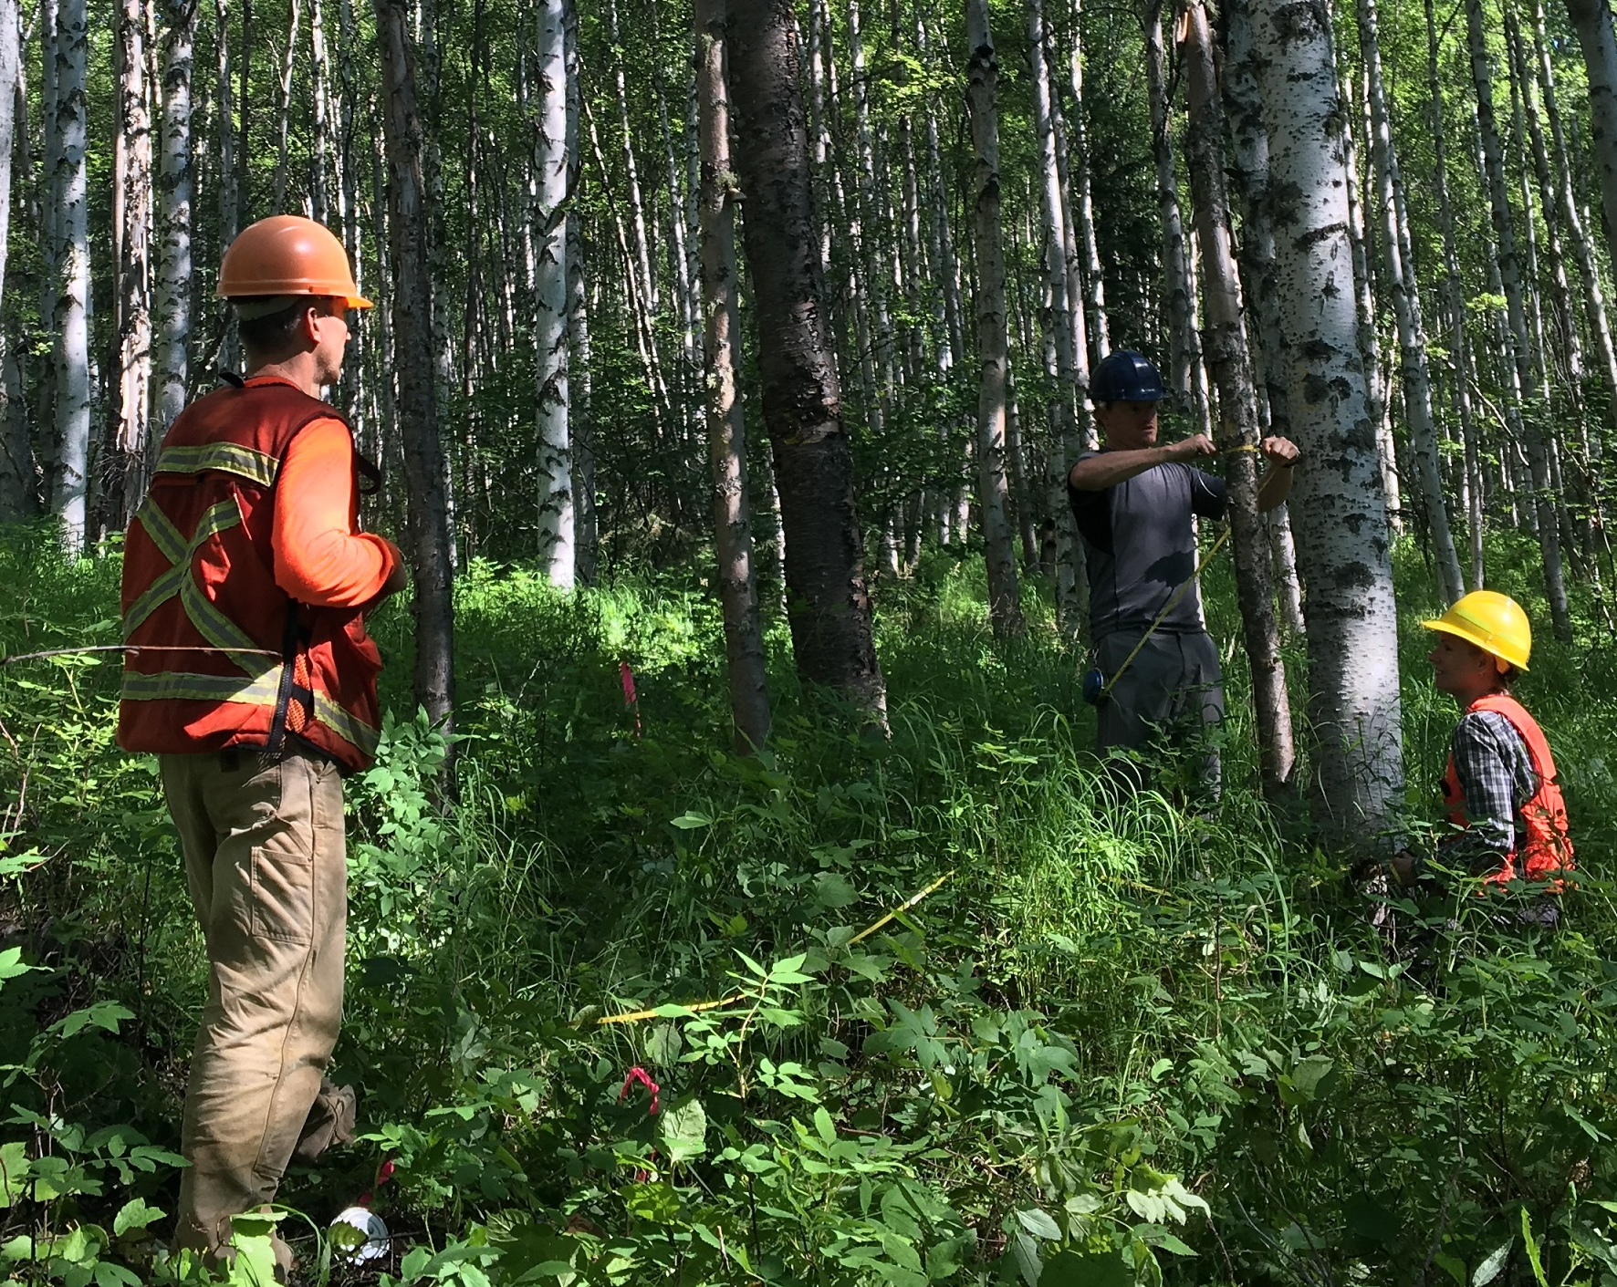
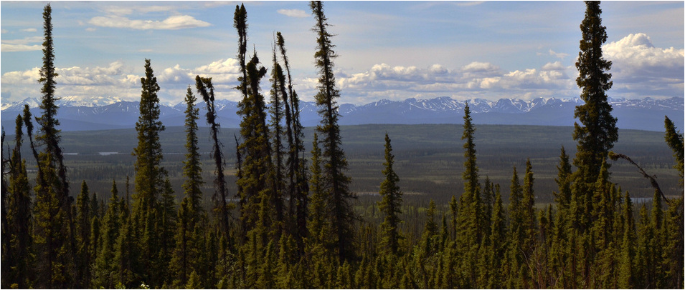

The Challenge: Biomass Estimation in Arctic & Boreal Regions

Slide 4
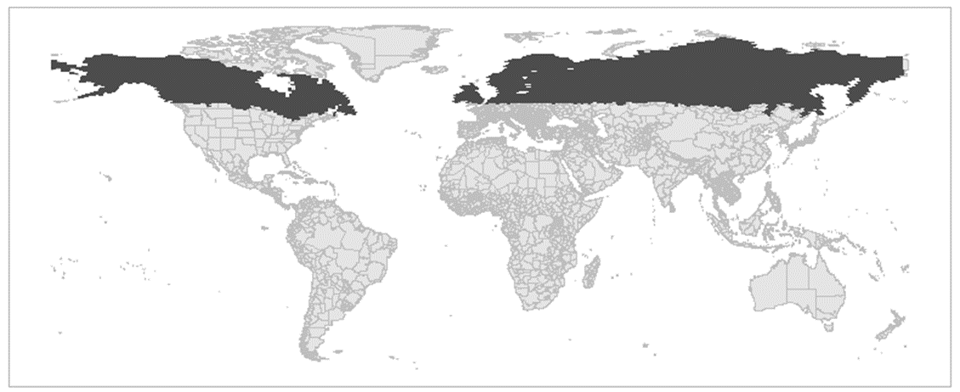
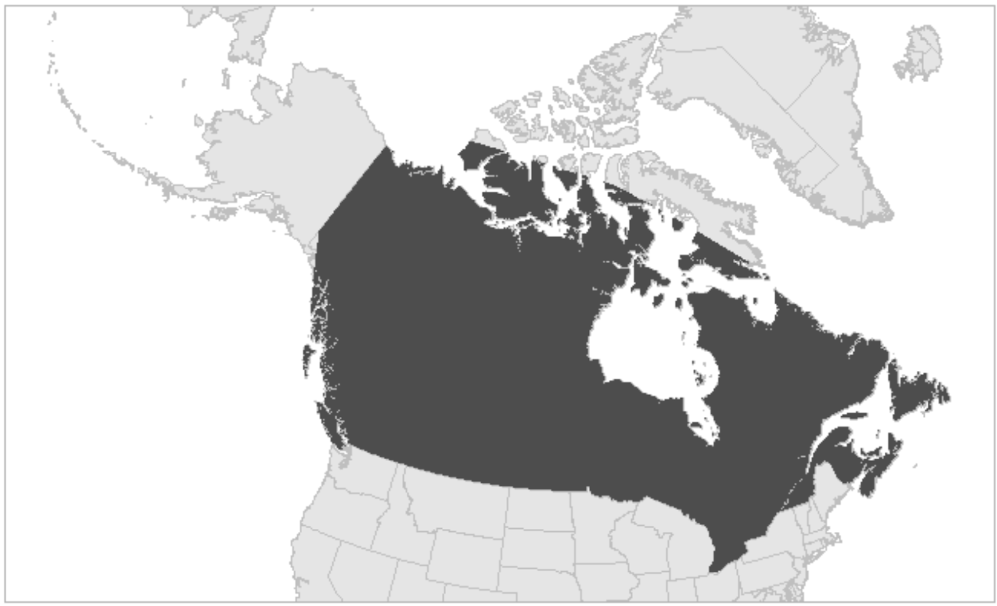
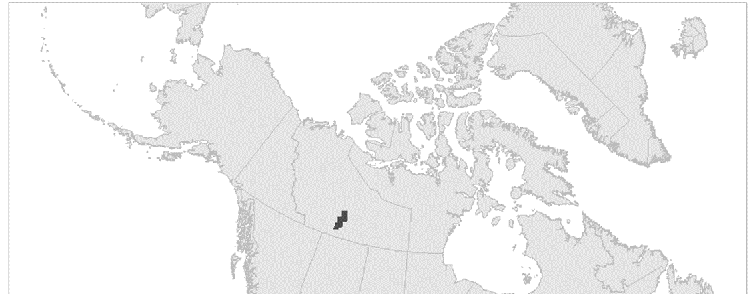
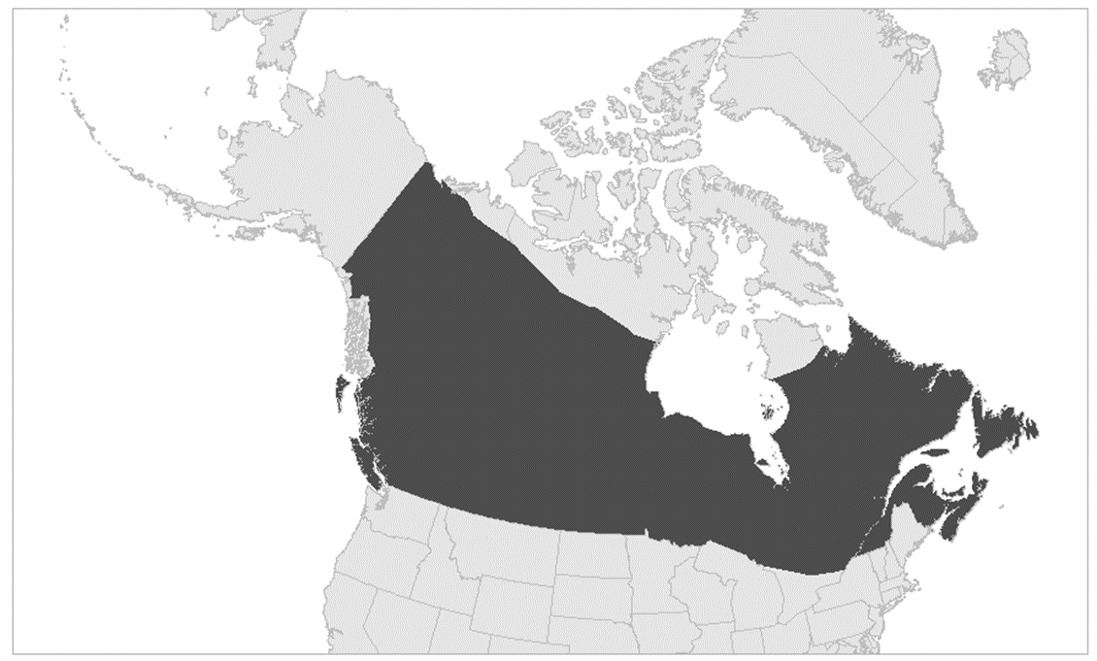
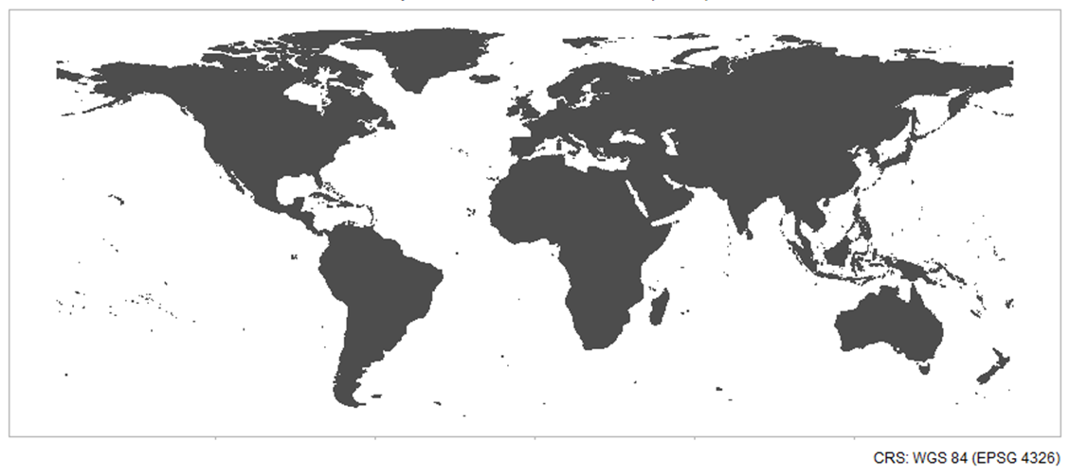
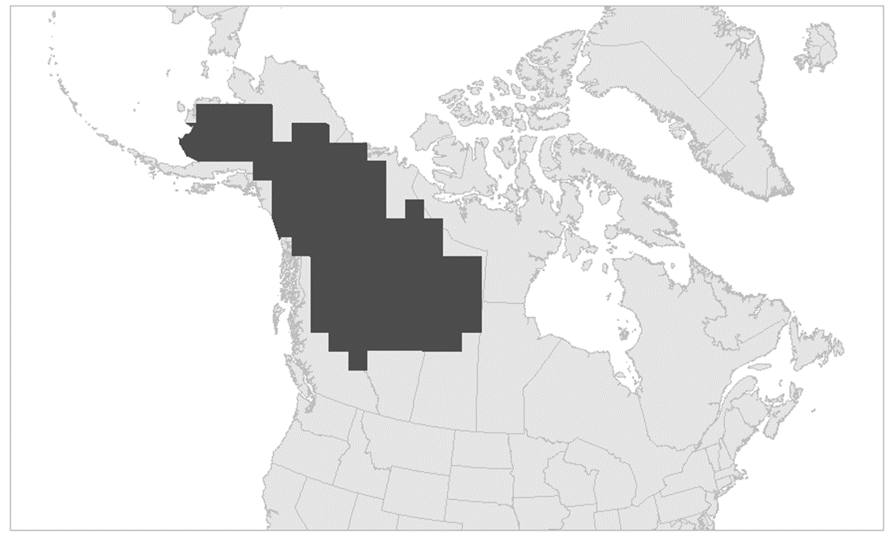
Comparing Biomass Maps: The Study
Published Maps | Area | Period | Res. (m) | Data Source | Modeling
Duncanson et al. (2025) |  | Circa 2020 | 30 | Harmonized Landsat & Sentinel-2 | Random forest Machine Learning
Guindon et al. (2024) |  | 2020 | 30 | Landsat | KNN, Random Forest Machine Learning
Kraatz et al. (2022) |  | 2019 | 100 | ALOS-2, Palsar-2 & UAV SAR | Simple regression
Matasci et al. (2018) |  | 2015 | 30 | Landsat | KNN, Random Forest Machine Learning
Soto-Navarro et al. (2020) |  | Circa 2010 | 300 | ESA Meris | Ensemble Model (Synthesis)
Spawn & Gibbs (2020) |  | 2010 | 300 | ESA, Meris & MODIS | Ensemble Model (Synthesis)
Wang et al. (2020) |  | 1984- 2014 | 30 | Landsat | Gradient Boosted Machine Learning
Xu et al. (2021) |  | 2000- 2019 | 10000 | ICESat, GLAS, JEDI & MODIS | Machine Learning

Slide 5
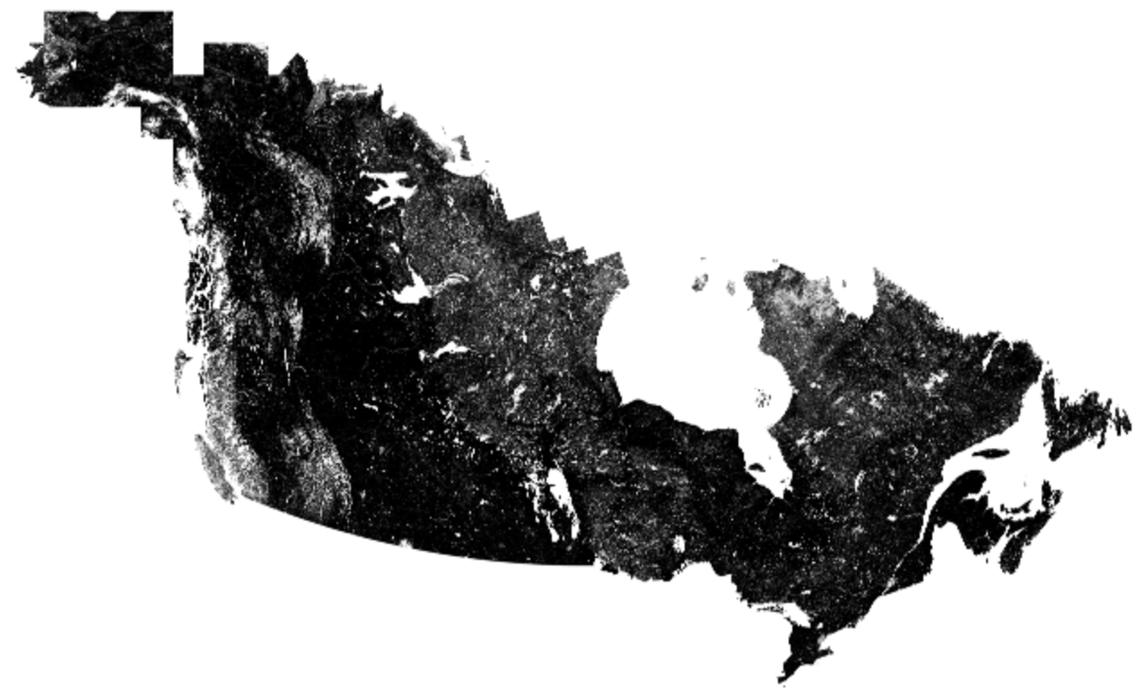
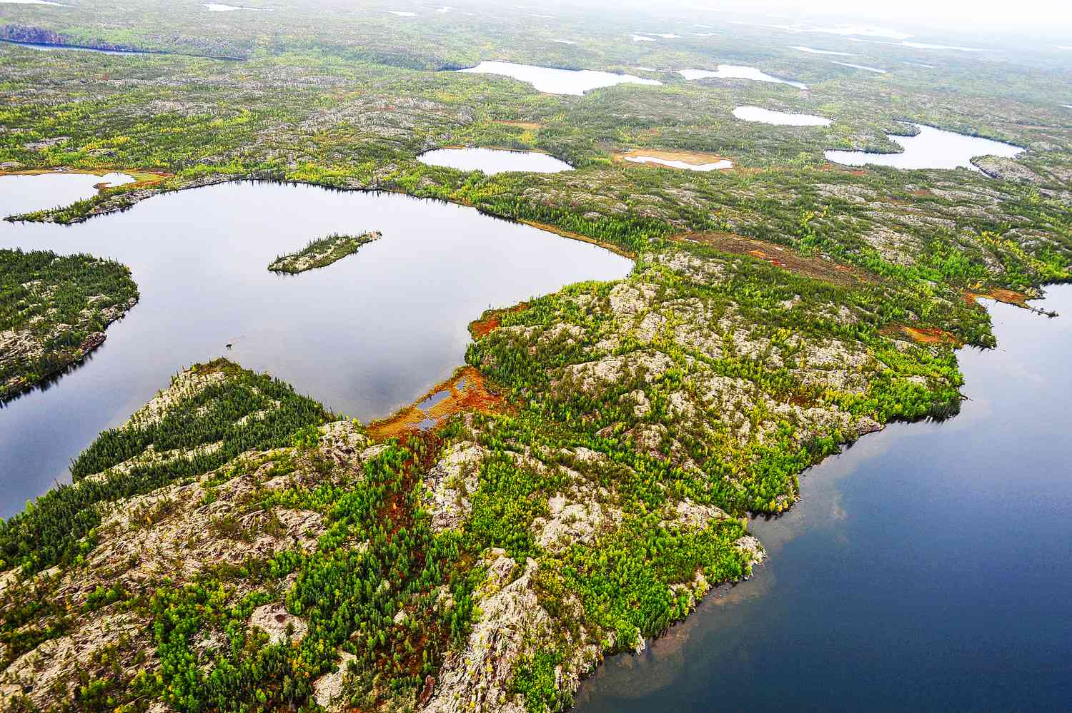
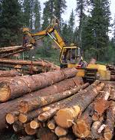
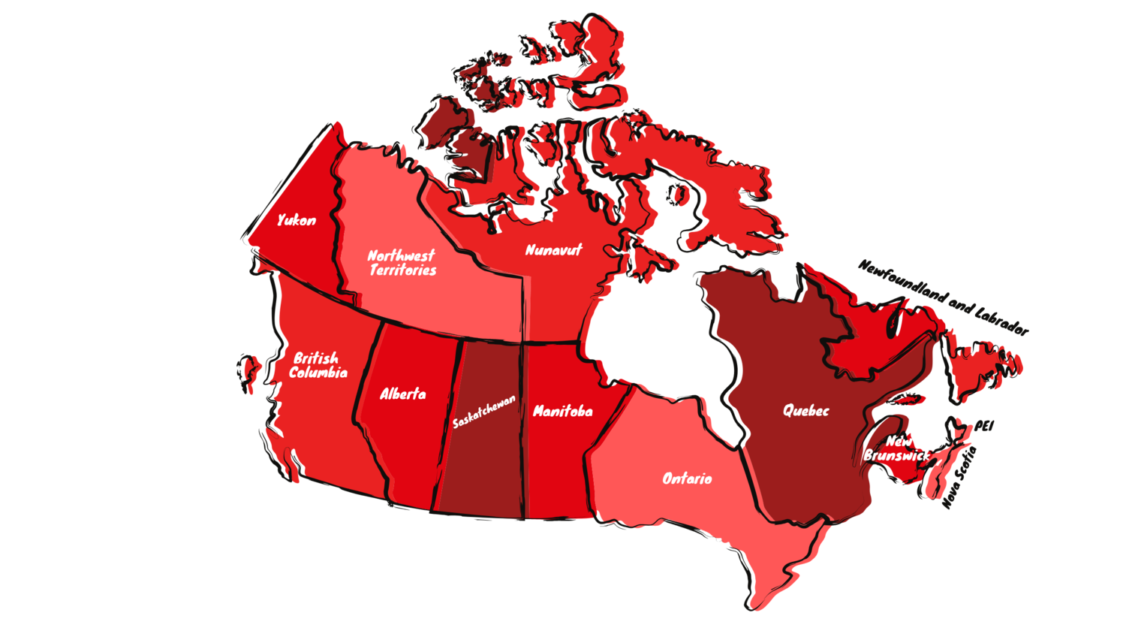
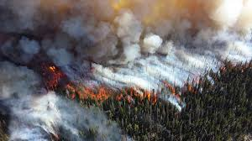
Methods: A quick mention
Common NA Mask Applied to Datasets and Compared
Biomass Estimates in Overlapping Areas (Great Slave Lake)
Regional Comparisons (Provinces & Ecoregions)
Ecosystem Impact Representation (Timber Harvest & Fire)

Slide 6
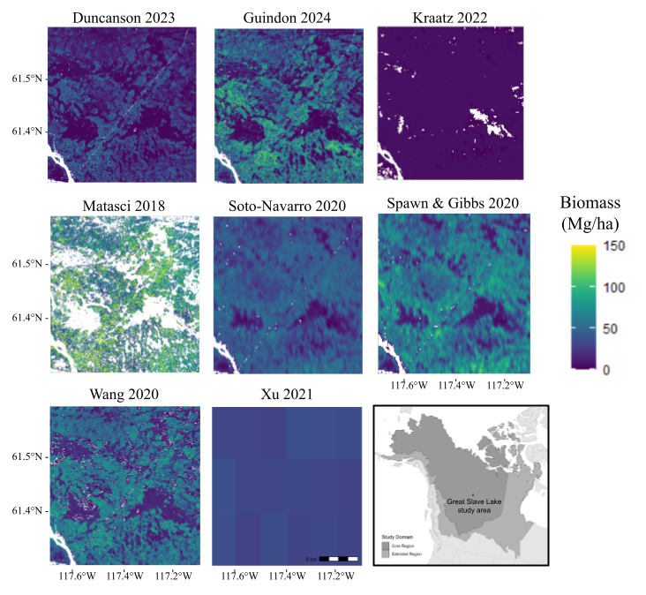
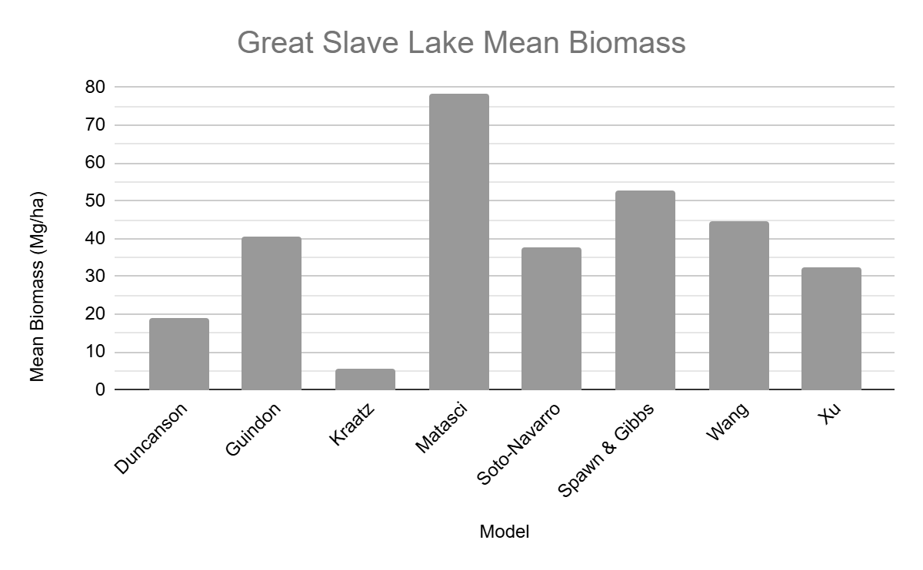
Findings: Biomass Estimates

Slide 7
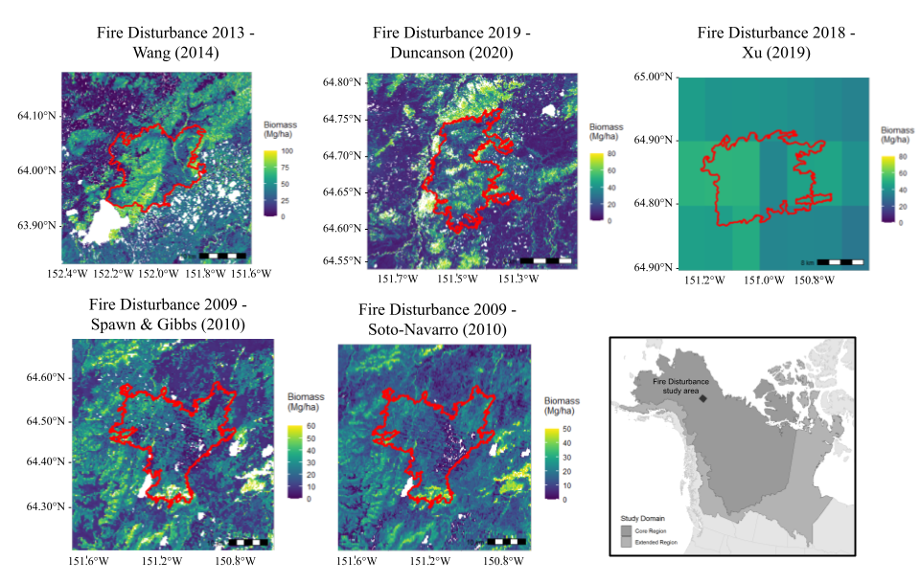
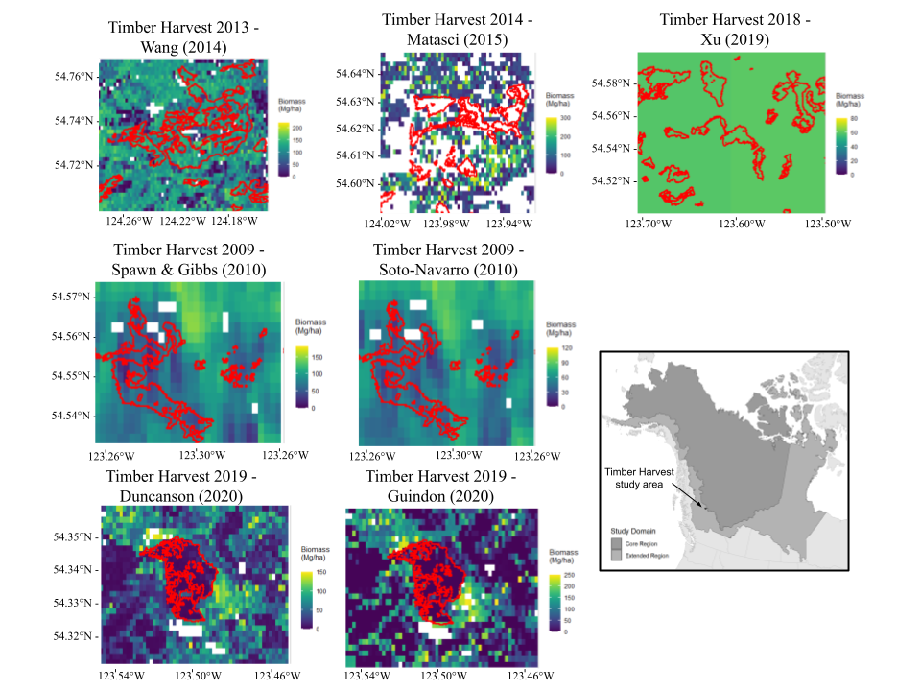
Findings: Capturing Ecosystem Effects
Fire Disturbance (1yr after fire)
Timber Harvest (1yr after harvest)

Slide 8
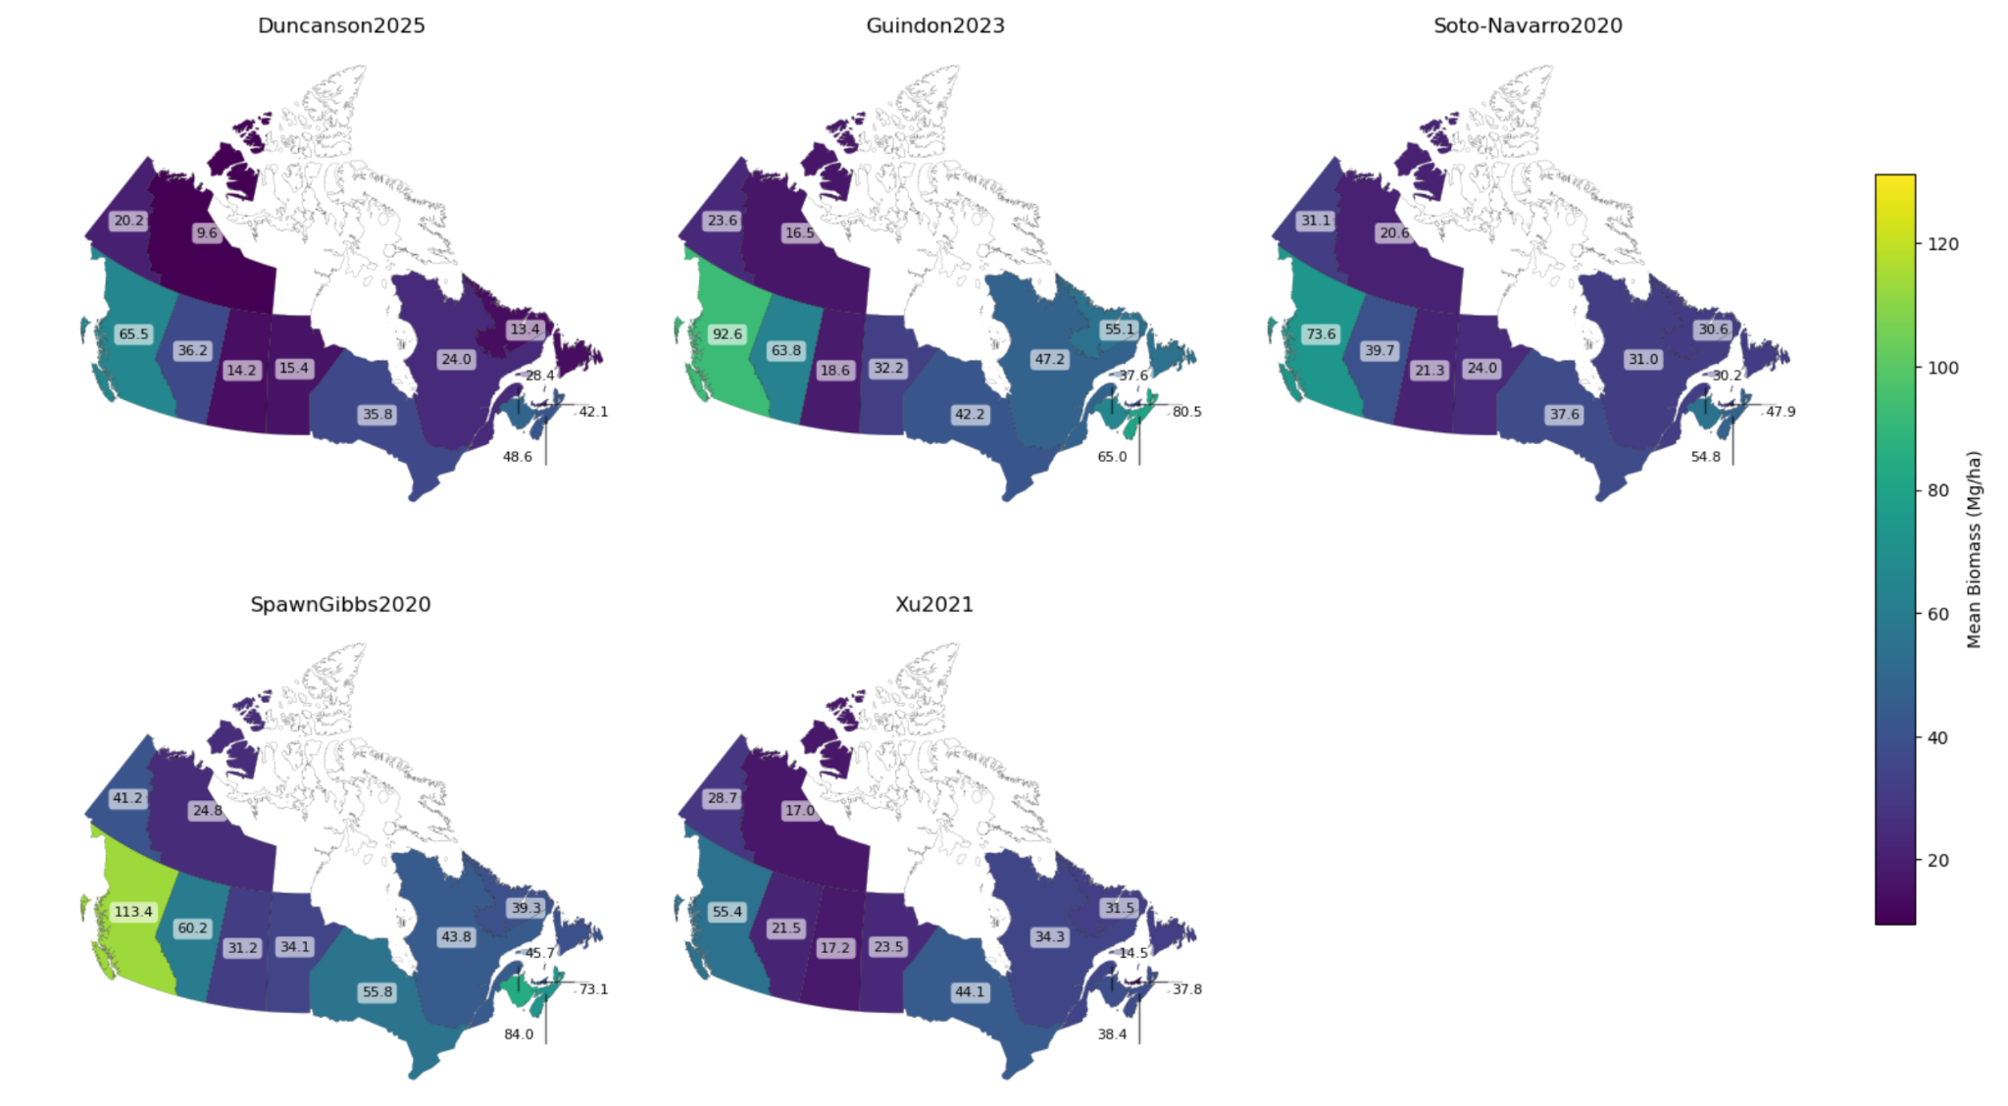
Findings: Regions - Provinces
Absolute biomass value varies between dataset
Trends in provinces with highest biomass are relatively consistent

Slide 9
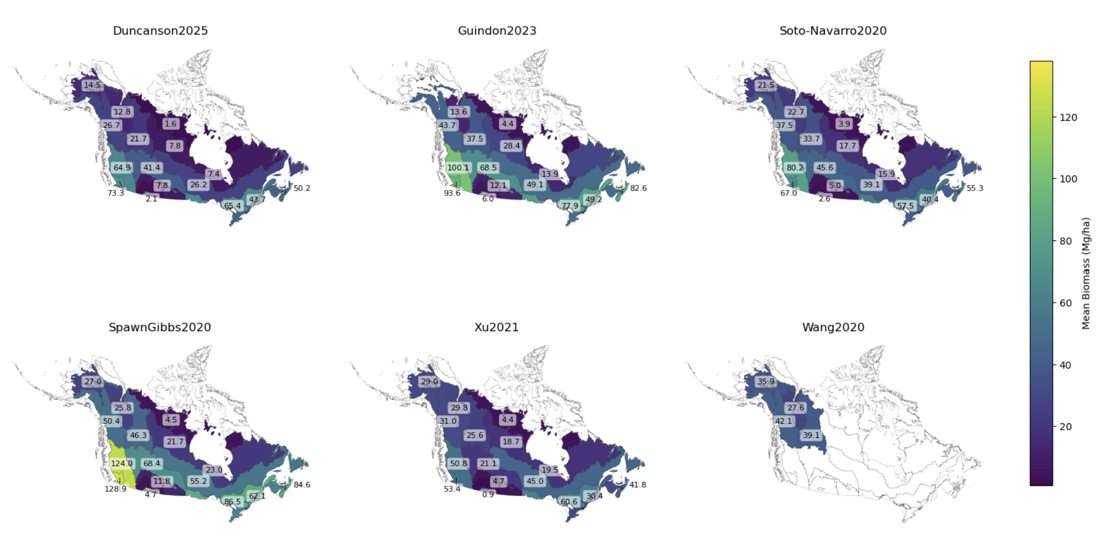
Findings: Regions - Ecoregions

Slide 10
Takeaways & Implications
📌 Regional vs. Global Trade-offs in Biomass Estimates 📌 Sensitivity to Disturbance Varies Across Models 📌 Uncertainty in Absolute Biomass Values 📌 Critical for Climate Models – Essential for Carbon
Budgets & Forest Management 📌 Next Steps – Paper Publishing & Presentations

Slide 11





Thank You
Collaborators
Devon Maloney
Elizabeth Hoy
Jon Wang
Paul Montesano
Wanwan Liang
Lab Support
Mack-Walker Lab
GEODE Lab
Mentor
Jeremy Forsythe

